Slide 1
GREEDY METHOD
KNAPSACK PROBLEM

Slide 2
Insights
Knapsack Problem – An Introduction
Knapsack Problem – Variants & Its difference.
Knapsack Problem
Example:
Solution 1 – Random Selection
Solution 2 - Decreasing order of Profits
Solution 3 – Increasing order of Weights
Solution 4 – Decreasing order of Profit per Weight
Greedy Algorithm for Knapsack Problem
Algorithm
Time Complexity

Slide 3
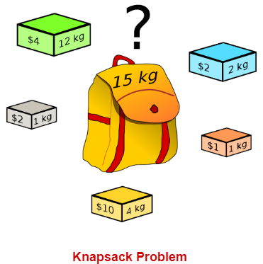
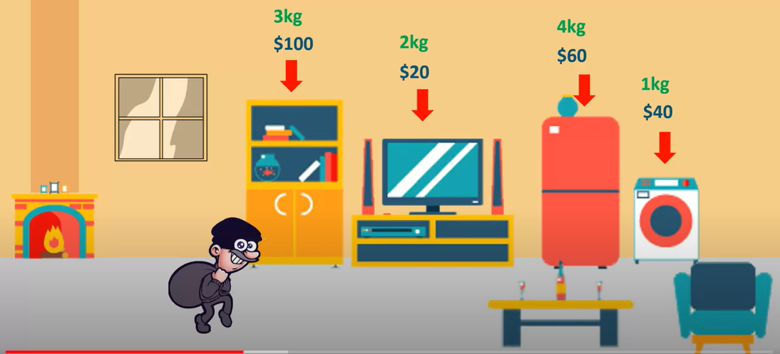
Knapsack Problem
You are given the following-
A knapsack (kind of shoulder bag) with limited weight capacity.
Few items each having some weight and value.
The problem states-
Which items should be placed into the knapsack such that-
The value or profit obtained by putting the items into the knapsack is maximum. And the weight limit of the knapsack does not exceed.

Slide 4

Knapsack Problem Variants & its differences
Variants:
0/1 Knapsack.
not allowed to break items. We either take the whole item or don’t take it.
Fractional Knapsack
can break items for maximizing the total value of knapsack
10kg
$10
4kg
$5
8kg
$20
7kg
$10
2kg
$3
6kg
$11
4kg
$2
8kg
$17

Slide 5
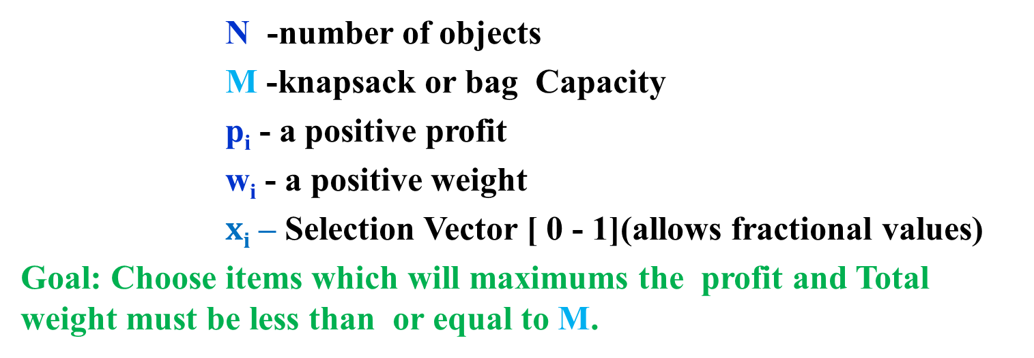
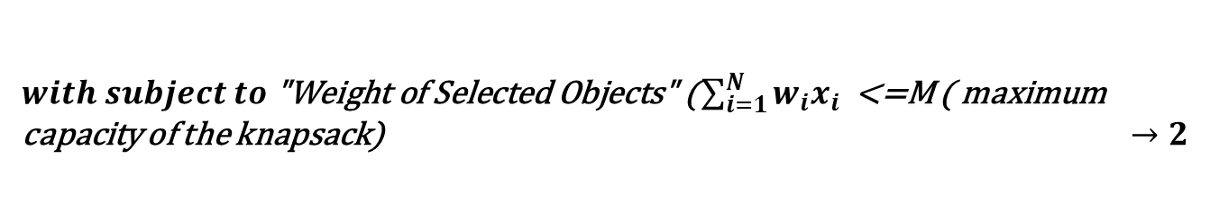
Knapsack Problem
N -number of objects
M -knapsack or bag Capacity
p_{i} - a positive profit
w_{i} - a positive weight
$xi$ – Selection Vector [ 0 - 1](allows fractional values)
Goal: Choose items which will maximums the profit and Total weight must be less than or equal to M.
$$maximize "Profit of the selected Object" (\sum_{i=1}^{N}{ρ_{i}x_{i}}) →1$$
$with subject to\text{ "}\text{Weight} \text{of} \text{Selected} \text{Objects}\text{" (}\sum_{i=1}^{N}{w_{i}x_{i}}$ <=M ( maximum capacity of the knapsack) $→2$
$$where 0< =xi≤1 and 1≤i≤N →3$$

Slide 6
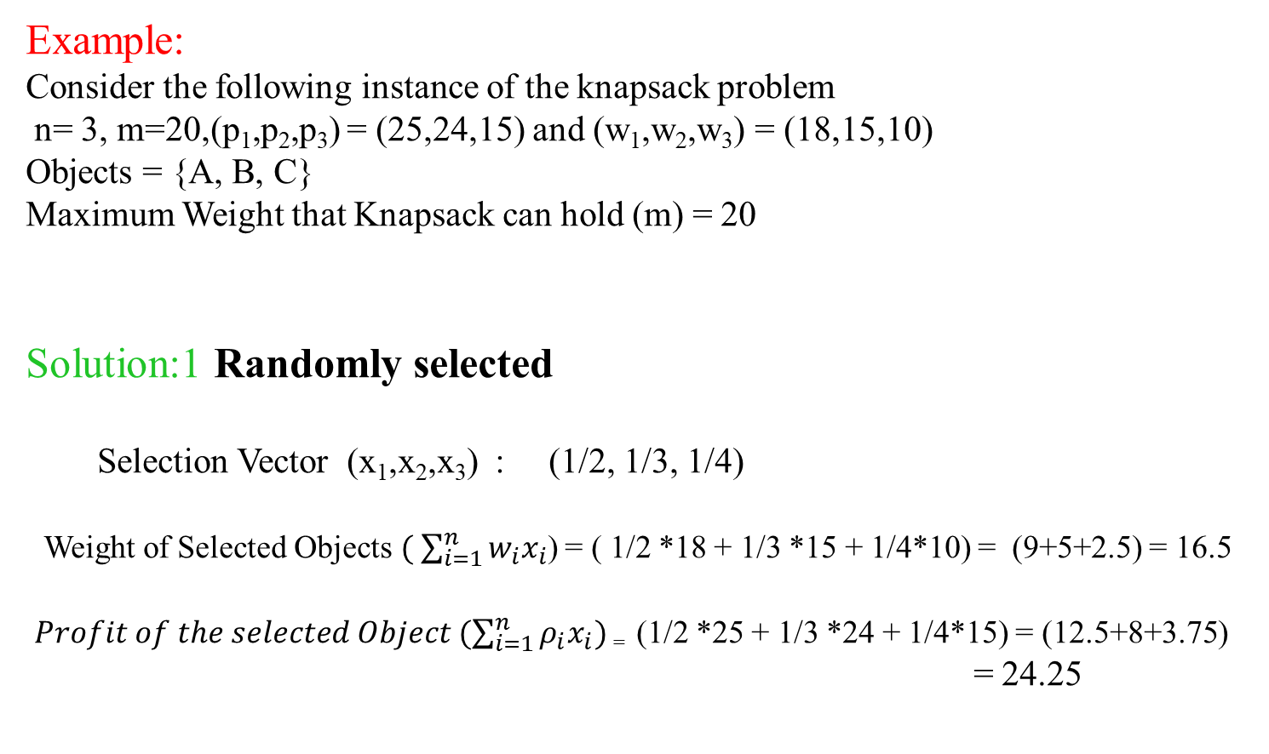
Knapsack Problem – Solution: Random Selection
Example:
Consider the following instance of the knapsack problem
n= 3, m=20,(p₁,p₂,p₃) = (25,24,15) and (w₁,w₂,w₃) = (18,15,10)
Objects = {A, B, C}
Maximum Weight that Knapsack can hold (m) = 20
Solution:1 Randomly selected
Selection Vector (x₁,x₂,x₃) : (1/2, 1/3, 1/4)
Weight of Selected Objects$( \sum_{i=1}^{n}{w_{i}x_{i}}$) = ( 1/2 *18 + 1/3 *15 + 1/4*10) = (9+5+2.5) = 16.5
$Profit of the selected Object (\sum_{i=1}^{n}{ρ_{i}x_{i}})$₌ (1/2 *25 + 1/3 *24 + 1/4*15) = (12.5+8+3.75) = 24.25
Objects | Profit (p_{i}) | Weight (w_{i})
A | 25 | 18
B | 24 | 15
C | 15 | 10
Maximum Weight that Knapsack can hold (m) = 20

Slide 7
Knapsack Problem – Solution: Decreasing Order of Profits
decreasing order of profits : A, B, C
Selection Vector (x₁,x₂,x₃) : (1,2/15,0)
Knapsack Weight = ∑ w_{i}x_{i} = ( 1*18 + 2/15*15 + 0*10) = (18+2+0) = 20
Profit = ∑ p_{i}x_{i =} (1 *25+ 2/15 *24+0*15) = (25+3.2+0) = 28.2
Objects | Profit (p_{i}) | Weight (w_{i})
A | 25 | 18
B | 24 | 15
C | 15 | 10
Maximum Weight that Knapsack can hold (m) = 20

Slide 8
Objects are arranged in increasing order of weights
: C, B, A
Selection Vector (x₁,x₂,x₃) : (0,2/3,1)
Knapsack Weight = ∑ w_{i}x_{i} = ( 0*18+ 2/3*15+1*10) = (0+10+10) = 20
Profit = ∑ p_{i}x_{i =} (0 *25+ 2/3 *24+1*15) = (0+16+15) = 31
Knapsack Problem – Solution: Increasing Order of Weights
Objects | Profit (p_{i}) | Weight (w_{i})
C | 15 | 10
B | 24 | 15
A | 25 | 18
Maximum Weight that Knapsack can hold (m) = 20

Slide 9
Objects are arranged in Decreasing order of p_{i}/w_{i} : B, C, A
Selection Vector (x₁,x₂,x₃) : (0,1,1/2)
Knapsack Weight = ∑ w_{i}x_{i} = ( 0*18+ 1*15+1/2*10) = (0+15+5) = 20
Profit = ∑ p_{i}x_{i} =(0 *25+ 1 *24+1/2*15) = (0+24+7.5)= 31.5
Knapsack Problem – Solution: Decreasing Order of Profits per Weight
Objects | Profit (p_{i}) | Weight (w_{i}) | P_{i} / w_{i}
B | 24 | 15 | 1.6
C | 15 | 10 | 1.5
A | 25 | 18 | 1.4
Maximum Weight that Knapsack can hold (m) = 20

Slide 10
GREEDY ALGORITHM FOR THE FRACTIONAL KNAPSACK PROBLEM
Algorithm GreedyKnapsack(m, n)
//P[1:n] and w[1:n] contain the profits and weights respectively of the n objects
// ordered such that p[i]/w[i] >= p[i+1]/w[i+1].
//m is the knapsack size and x[1:n] is the solution vector.
{
for i :=1 to n do
x[i] := 0.0; // Initialize x.
U := m; //Knapsack Size
for i := 1 to n do {
if ( w[i] > U ) then
break;
x[i] := 1
U := U - w[i];
}
if ( i <= n) then
x[i] := U/w[i];
}

Slide 11
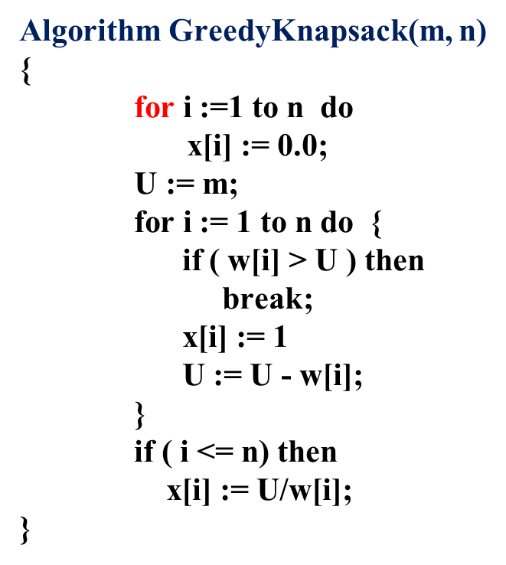
GREEDY ALGORITHM FOR THE FRACTIONAL KNAPSACK PROBLEM
P=30
W=20
P=15
W=5
P=20
W=10
Knapsack

Slide 12
GREEDY ALGORITHM FOR THE FRACTIONAL KNAPSACK PROBLEM
P=15
W=5
P=20
W=10
P=30
W=20
Knapsack

Slide 13
GREEDY ALGORITHM FOR THE FRACTIONAL KNAPSACK PROBLEM
P=15
W=5
P=20
W=10
P=30
W=20
Knapsack
M=15

Slide 14
GREEDY ALGORITHM FOR THE FRACTIONAL KNAPSACK PROBLEM
P=15
W=5
P=20
W=10
P=30
W=20
Knapsack
M=15
N=3
X=[ 0.0 0.0 0.0]
U=15
i=N/A

Slide 15
GREEDY ALGORITHM FOR THE FRACTIONAL KNAPSACK PROBLEM
P=15
W=5
P=20
W=10
P=30
W=20
N=3
X=[ 1.0 0.0 0.0]
U=10
i=1
Knapsack
M=15

Slide 16
GREEDY ALGORITHM FOR THE FRACTIONAL KNAPSACK PROBLEM
P=20
W=10
P=30
W=20
N=3
X=[ 1.0 1.0 0.0]
U=0
i=2
Knapsack
M=15
P=15
W=5

Slide 17
GREEDY ALGORITHM FOR THE FRACTIONAL KNAPSACK PROBLEM
P=30
W=20
N=3
X=[ 1.0 1.0 0.0]
U=0
i=3
Knapsack
M=15
P=20
W=10
P=15
W=5

Slide 18
GREEDY ALGORITHM FOR THE FRACTIONAL KNAPSACK PROBLEM
P=30
W=20
N=3
X=[ 1.0 1.0 0.0]
U=0
i=3
Knapsack
M=15
P=20
W=10
P=15
W=5

Slide 19
GREEDY ALGORITHM FOR THE FRACTIONAL KNAPSACK PROBLEM
Algorithm GreedyKnapsack(m, n)
{
for i :=1 to n do
x[i] := 0.0; // Initialize x.
U := m; //Knapsack Size
for i := 1 to n do {
if ( w[i] > U ) then
break;
x[i] := 1
U := U - w[i];
}
if ( i <= n) then
x[i] := U/w[i];
}
Time Complexity = O(n)

